Slide 1
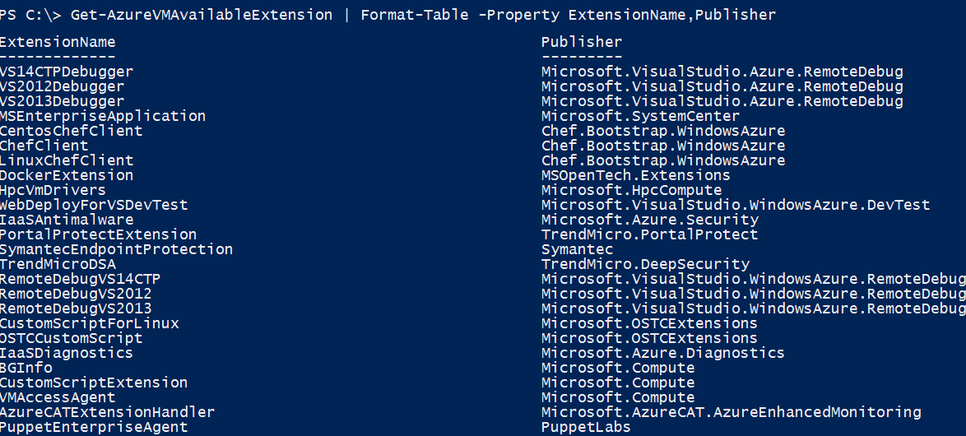
VM Extensions
List available VM extensions
Microsoft Azure

Slide 2
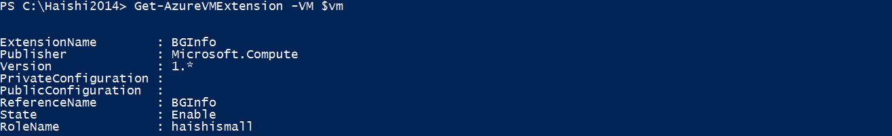
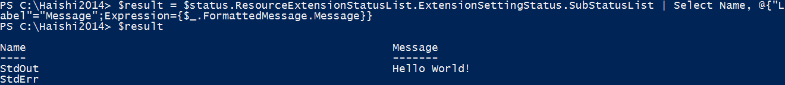
VM Extensions
Before Custom Script Extension is installed
Script execution result
Microsoft Azure

Slide 3
Azure Files vs Disks
Before Custom Script Extension is installed
Description | Disk | Azure Files
Relationship with Azure VMs | Required for booting (OS Disk)
Scope | Exclusive/Isolated to a single VM | Shared access across multiple VMs
Snapshots and Copy | Yes | No
Configuration | Configured via portal/Management APIs and available at boot time | Connect after boot (via net use on windows)
Built-in authentication | Built-in authentication | Set up authentication on net use
Cleanup | Resources can be cleaned up with VM if needed | Manually via standard file APIs or REST APIs
Access via REST | Can only access as fixed formatted VHD (single blob) via REST. Files stored in VHD cannot be accessed via REST. | Individual files stored in share are accessible via REST
Max Size | 1TB Disk | 5TB File Share 1TB file within share
Max 8KB IOps | 500 IOps | 1000 IOps
Throughput | Up to 60 MB/s per Disk | Up to 60 MB/s per File Share
Notes:
Speaker Notes:
Unhide to add more details if necessary

